Slide 1

Virtual memory paging
Operating System (Lab) Project
Instructor : Aadrish Pirzado
PRESNETED BY AHMED ALI ANSARI (1402-2020) , Muhammad Taha Qadri (1197-2020) , Muhammad Hanan Faisal (961-2020)
DATED : 1/11/2023
Course Operating Systems Lab

Slide 2
AGENDA
Introductions​ to virtual memory
Paging Concept
Paging Workflow Diagram
Paging Project Code & Output
Closing​
2
CONTOSO ALL-HANDS

Slide 3

INTRO TO VIRTUAL MEMORY
“ Virtual memory is a feature in OS , where the programs can be store themselves in from of pages while their execution and only the required pages or of process are located into the main memory.
Virtual memory is a imaginary memory which we are assuming . If we have material that exceed your memory at that time we need to use the concept of virtual memory . Virtual memory is temporary which is used along with the RAM of the system “

Slide 4
Paging Concept
Virtual memory can be implemented by suing Demand paging.
Could bring entire process into memory at load time Or bring a page into memory only when it is needed  Less I/O needed, no unnecessary I/O
Less memory needed
Faster response
More users Similar to paging system with swapping (diagram on right) Page is needed
reference to it
invalid reference -> abort
not-in-memory -> bring to memory Lazy swapper – never swaps a page into memory unless page will be needed
Swapper that deals with pages is a pager

Slide 5
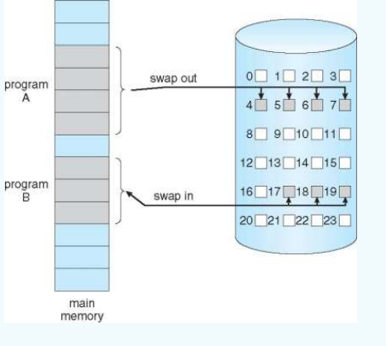
Paging Workflow Diagram

Slide 6
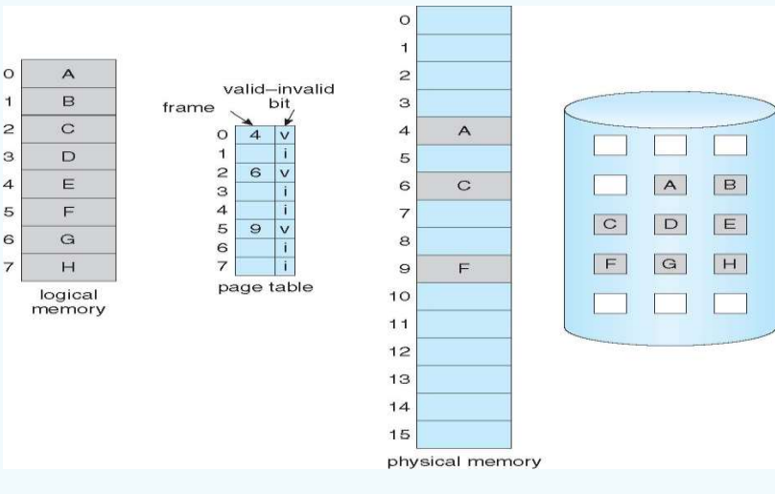
PAGE TABLE WHEN SOME PAGES ARE NOT IN MAIN MEMORY

Slide 7
Paging Project Code
def main():
page_mapping = []
physical_frame_table = []
virtual_page_table = []
size = int(input("How many words will you enter? "))
word_size = int(input("Enter word size: "))
virtual_page_table = set_virtual_page_table(
virtual_page_table=virtual_page_table, size=size, word_size=word_size)
page_mapping = set_page_mapping(page_mapping=page_mapping, size=size)
sorted_mapping = list(page_mapping)
sorted_mapping.sort()
physical_frame_table = get_physical_frame_table(
page_mapping, physical_frame_table, virtual_page_table, sorted_mapping[-1], word_size)

Slide 8
Paging Project Code
print("Virtual Page Table[] : {}".format(virtual_page_table))
print("Page Mapping[] : {}".format(page_mapping))
print("Physical Frame Table[] : {}".format(physical_frame_table))
def set_virtual_page_table(virtual_page_table=[], size=0, word_size=0):
temp = []
for offset in range(0, size):
for elem in range(0, word_size):
temp.append(
input("Enter value for offset #{}[{}]: ".format(offset, elem)))
virtual_page_table.append(temp)
temp = []
return virtual_page_table
def set_page_mapping(page_mapping=[], size=0):
for offset in range(0, size):
page_mapping.append(
int(input("Enter page number for offset #{}: ".format(offset))))

Slide 9
Paging Project Code
return page_mapping
def get_physical_frame_table(page_mapping=[], physical_frame_table=[], virtual_page_table=[], upperbound=0, word_size=0):
for frame_number in range(0, upperbound + 1):
physical_frame_table.append([
frame_number * word_size,
virtual_page_table[page_mapping.index(
frame_number)] if frame_number in page_mapping else None
])
return physical_frame_table
if __name__ == '__main__':
import os
os.system('clear')
main()

Slide 10
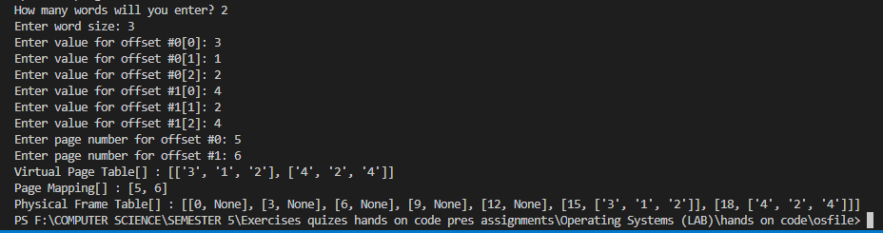
Paging Project Output

Slide 11

CLOSING
THANKYOU THAT’S IT FROM THE GROUP

